Slide 1
Music and Ritual
Classroom Resources from St Cecilia’s Hall: Concert Hall and Music Museum

Slide 2
Lesson 1: What is Ritual?

Slide 3
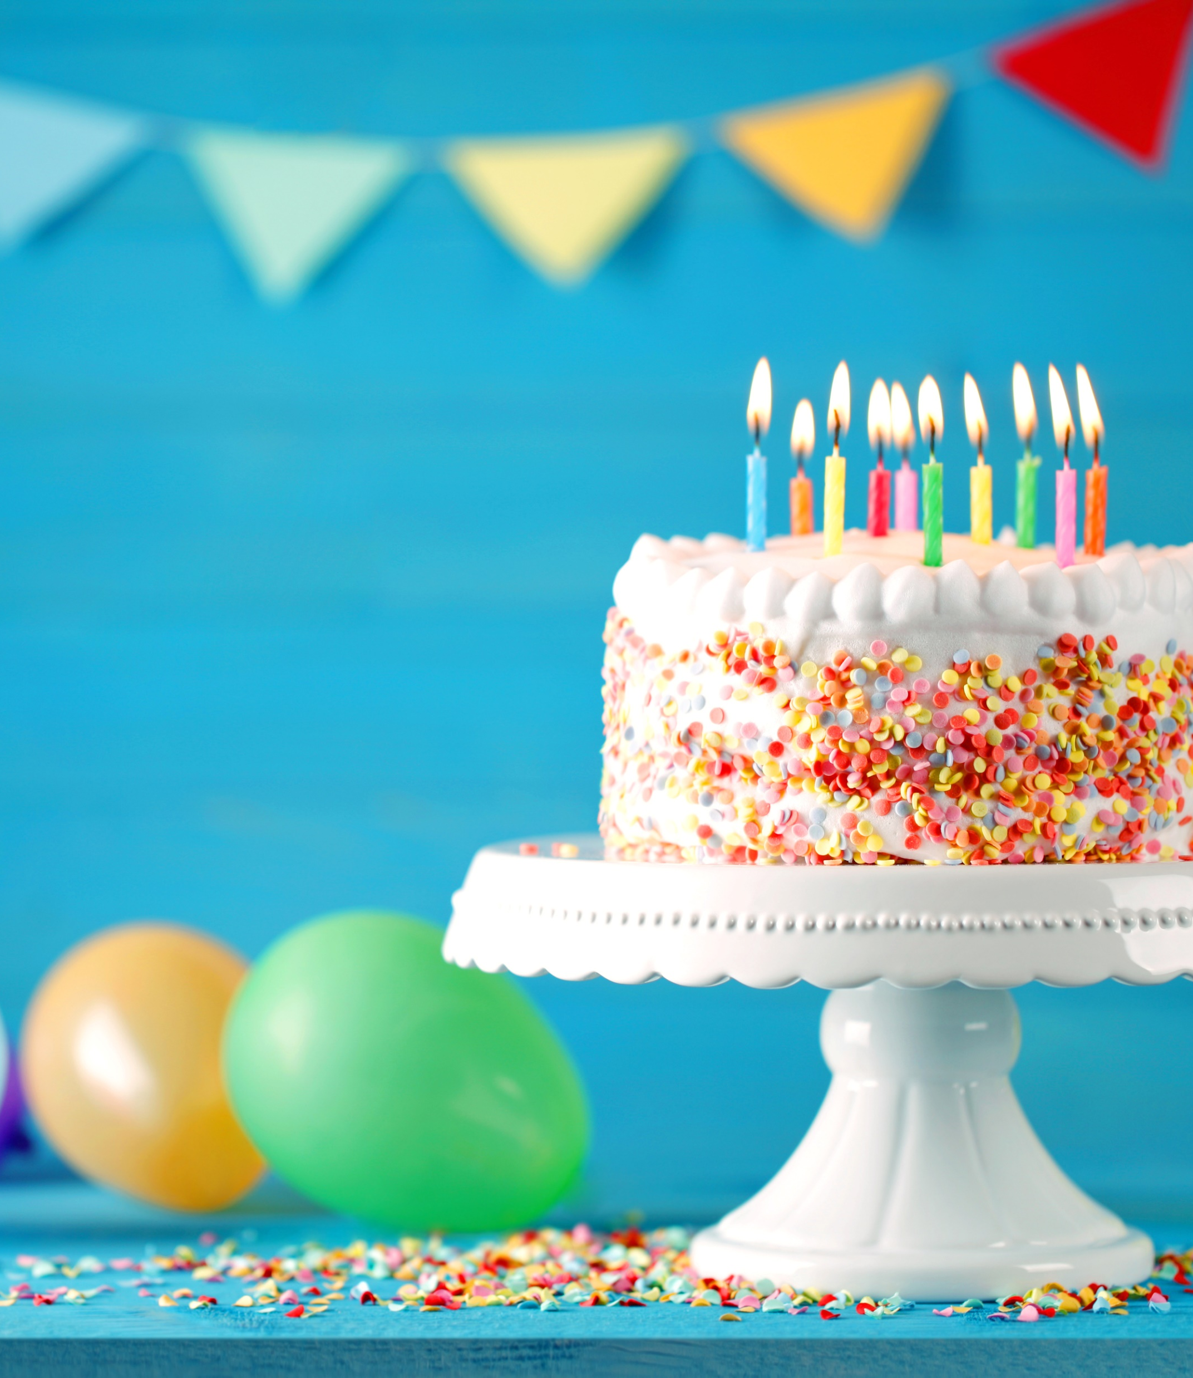
Has anyone had a birthday recently?
What is a common way to wish someone a happy birthday?
THROUGH A SONG! Can you all sing ‘Happy Birthday’ to someone who had a birthday recently?
Or, listen to this orchestra playing the song and try to sing along:

Slide 4
Can you think of other examples of when music is used for special occasions?
What songs do you sing around Christmas?
Does your school have a song you sing at assemblies?

Slide 5
What does ‘ritual’ mean?
A ritual is an action or a series of actions which is always performed in the same way – it can be religious or non-religious.
Why do you think music is important in rituals? Does it make you feel joyful, or like you want to dance? For instance, how did you feel when you sang ‘Happy birthday’? How did the person whose birthday it was feel?

Slide 6
Activity 1: Matching Game
On your separate sheet, try to match the picture of each instrument with its use – don’t worry if you have to guess! We’ll play a recording of the instrument being used so you can hear what it sounds like before you guess.

Slide 7
Here is a drumkit being played – which use do you think matches the sound?
What about a singing bowl? Here’s a clue: does the sound make you feel calm or excited?
Here is a pipa – this is a tricky one!

Slide 8
These are Batá drums playing. What do you think they might be used for?
This is what a lute sounds like – does it sound new or ancient to you?
And lastly, here is an organ. It is a big, heavy instrument which can’t be moved out of its building very easily!

Slide 9
Activity 2: Making up a dramatic or dance response to music
In groups, make up a short (20-30 seconds) dramatic or dance response to one of the following pieces of music.
You can choose from 3 different pieces. Think about their character, speed, loudness, and the types of sound you hear.
Each piece is a piece of classical music. Classical music is mostly music composed in Europe from around 1600-1910. It uses many different instruments – you’ll hear a whole orchestra and individual instruments.

Slide 10
Piece 1: Opening of ‘Symphony No.5’, by Gustav Mahler
Piece 2: ‘Lullaby’, by Johannes Brahms
Piece 3: ‘Dance of the Sugar Plum Fairy’, by Pyotr Ilyich Tchaikovsky

Slide 11
discussion
How did you feel when you heard this music?
Did you enjoy working with your group to produce the dance?
Was it difficult in any way?
How did you make sure that everyone shared their ideas/took part?

