Slide 1
Music and Ritual
Classroom Resources from St Cecilia’s Hall: Concert Hall and Music Museum

Slide 2
Lesson 2: Music, Celebration, and religion

Slide 3
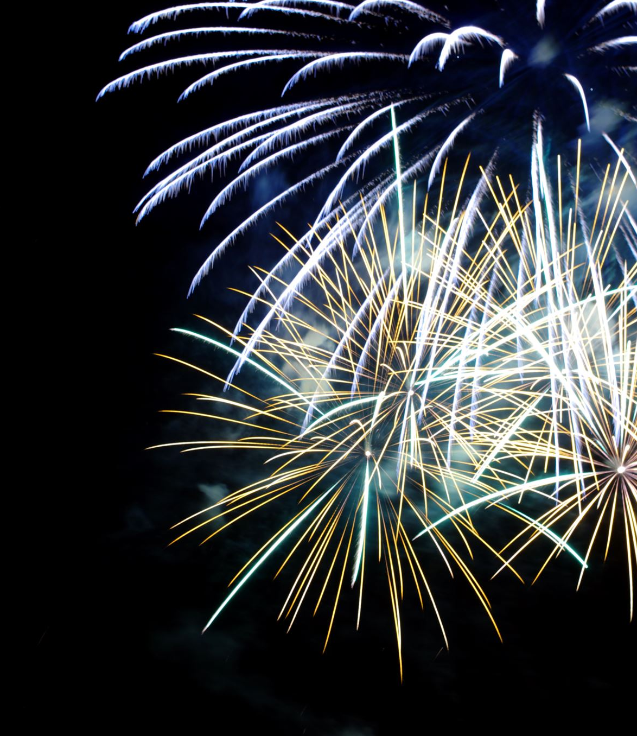
What is a famous song we sing at New Year, especially in Scotland?
‘Auld Lang Syne’!
It is about friendship and remembering the past year and you will often hear it as fireworks go off.
Why do you think singing together makes people happy?
Here is a verse and chorus of ‘Auld Lang Syne’ – sing along if you know it!

Slide 4
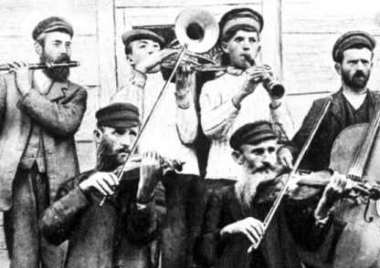
Music and celebration: Klezmer wedding music
Music is used all over the world in many celebrations.
Klezmer music is part of Jewish traditions from Eastern Europe. Most Klezmer pieces are for dancing to, at weddings for instance.
Can you identify any of the instruments in this picture?

Slide 5
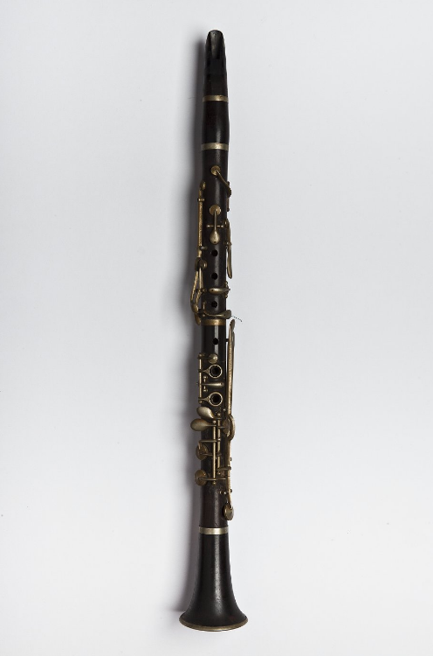
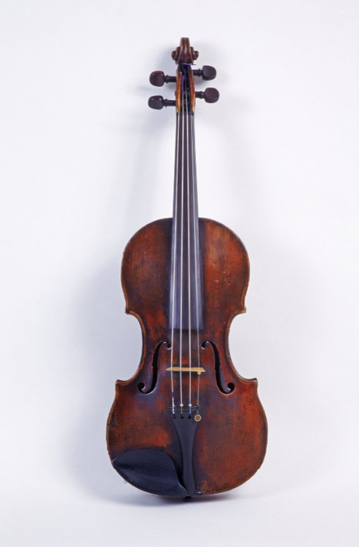
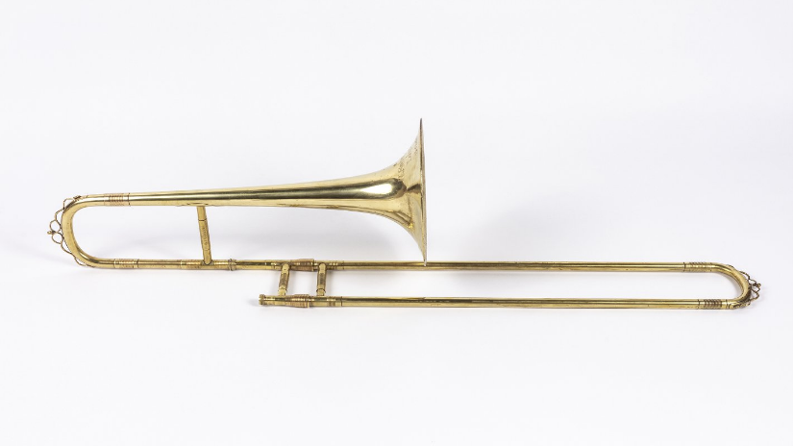
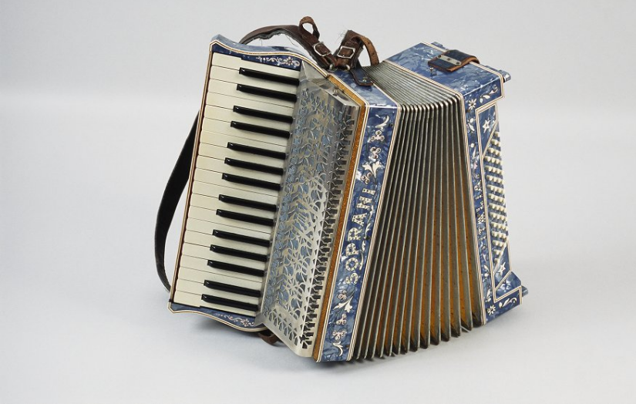
Trombone
Accordion
Clarinet
Violin
Here are some instruments used in Klezmer music
Here is an example of Klezmer wedding music

Slide 6
discussion
In what way is this music different to music we may hear at a wedding in Scotland?
How does it make you feel?
How would you describe the sounds in this music?
Listen to the music again and draw the patterns or shapes you hear in it!

Slide 7
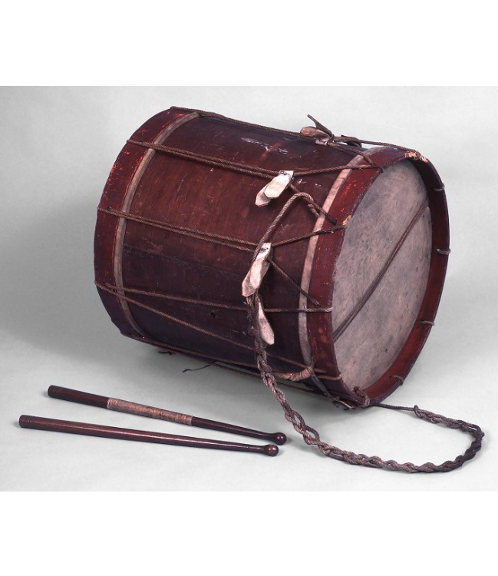
Energiser!
This is a military side-drum. They were played by soldiers while marching into battle.
Why might a group of soldiers need a drum?
Clue: How do they keep their marching in time?
Try walking on the spot in time with each other, first in silence, then with someone beating a steady pulse on a ‘drum’ (this can be a pot or box and wooden spoon or similar) – which was easier?

Slide 8
Music and religion
What does this sound make you think of?
Christmas!
Music is part of many religious rituals, which non-religious people often also take part in.

Slide 9
The ney is a flute from the Middle East which has been played for nearly 5,000 years, making it one of the oldest musical instruments in use today.
In Turkey, the ney is used by Sufi Muslims during ‘whirling’ rites, in which they turn round and round while focussing on the music as a form of worship.
Here is what the ney sounds like

Slide 10
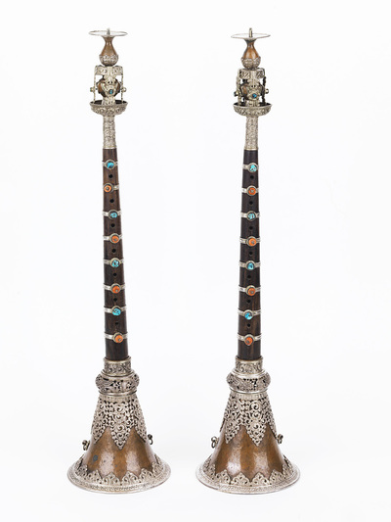
The Gyaling is a woodwind instrument used in Buddhist temples in Tibet.
The colours and materials this instrument is made of are symbolic for Tibetan Buddhists: turquoise, like the blue of the sea and sky, represents the spiritual heights Buddhists strive to reach and red coral is associated with success and good health.
Here is what the gyaling sounds like – the sound is intended to invite spirits into the monastery.

Slide 11
discussion
Listen to the ney and the gyaling again and draw the patterns, colours, or shapes you hear in each.
Look back at your picture for Klezmer music – what similarities and differences are there in your drawings?
Why do you think music is often used in religious rituals?
What emotions did you feel when listening to these musical instruments?

