Slide 1
Music and Ritual
Classroom Resources from St Cecilia’s Hall: Concert Hall and Music Museum

Slide 2
Lesson 3: Music and ritual in everyday life

Slide 3
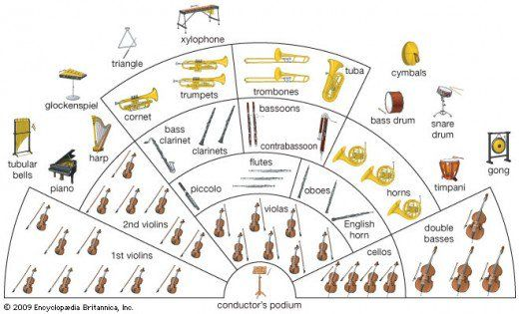
Rituals in classical music
This is a picture of a Western classical orchestra – how many instruments can you identity?

Slide 4
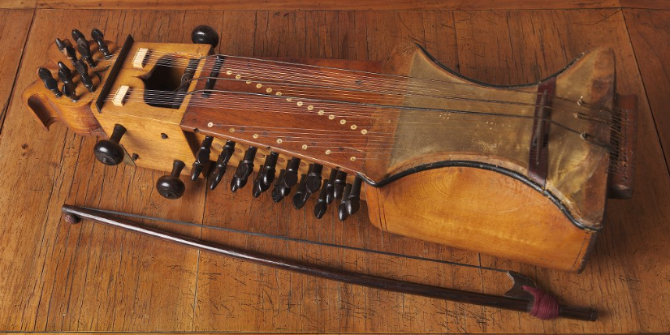
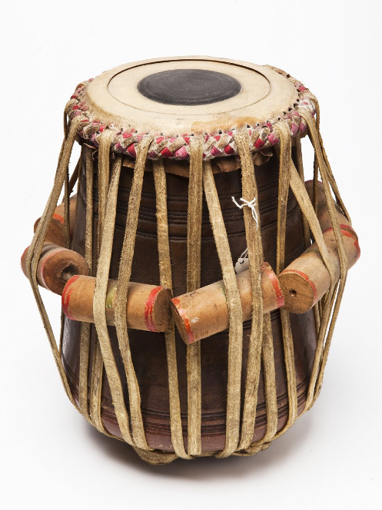
Rituals in classical music
Instruments such as the flute, cello, and trumpet are often used in classical music in Europe, but there are other classical musics around the world which use different instruments.
For instance, in India, Hindustani classical music uses instruments such as the sarangi (top picture) and tabla (bottom picture) – can you guess how you would play each one?
Listen to this example of Hindustani classical music and try to pick out the tabla (the drum). Can you tap or clap along?

Slide 5
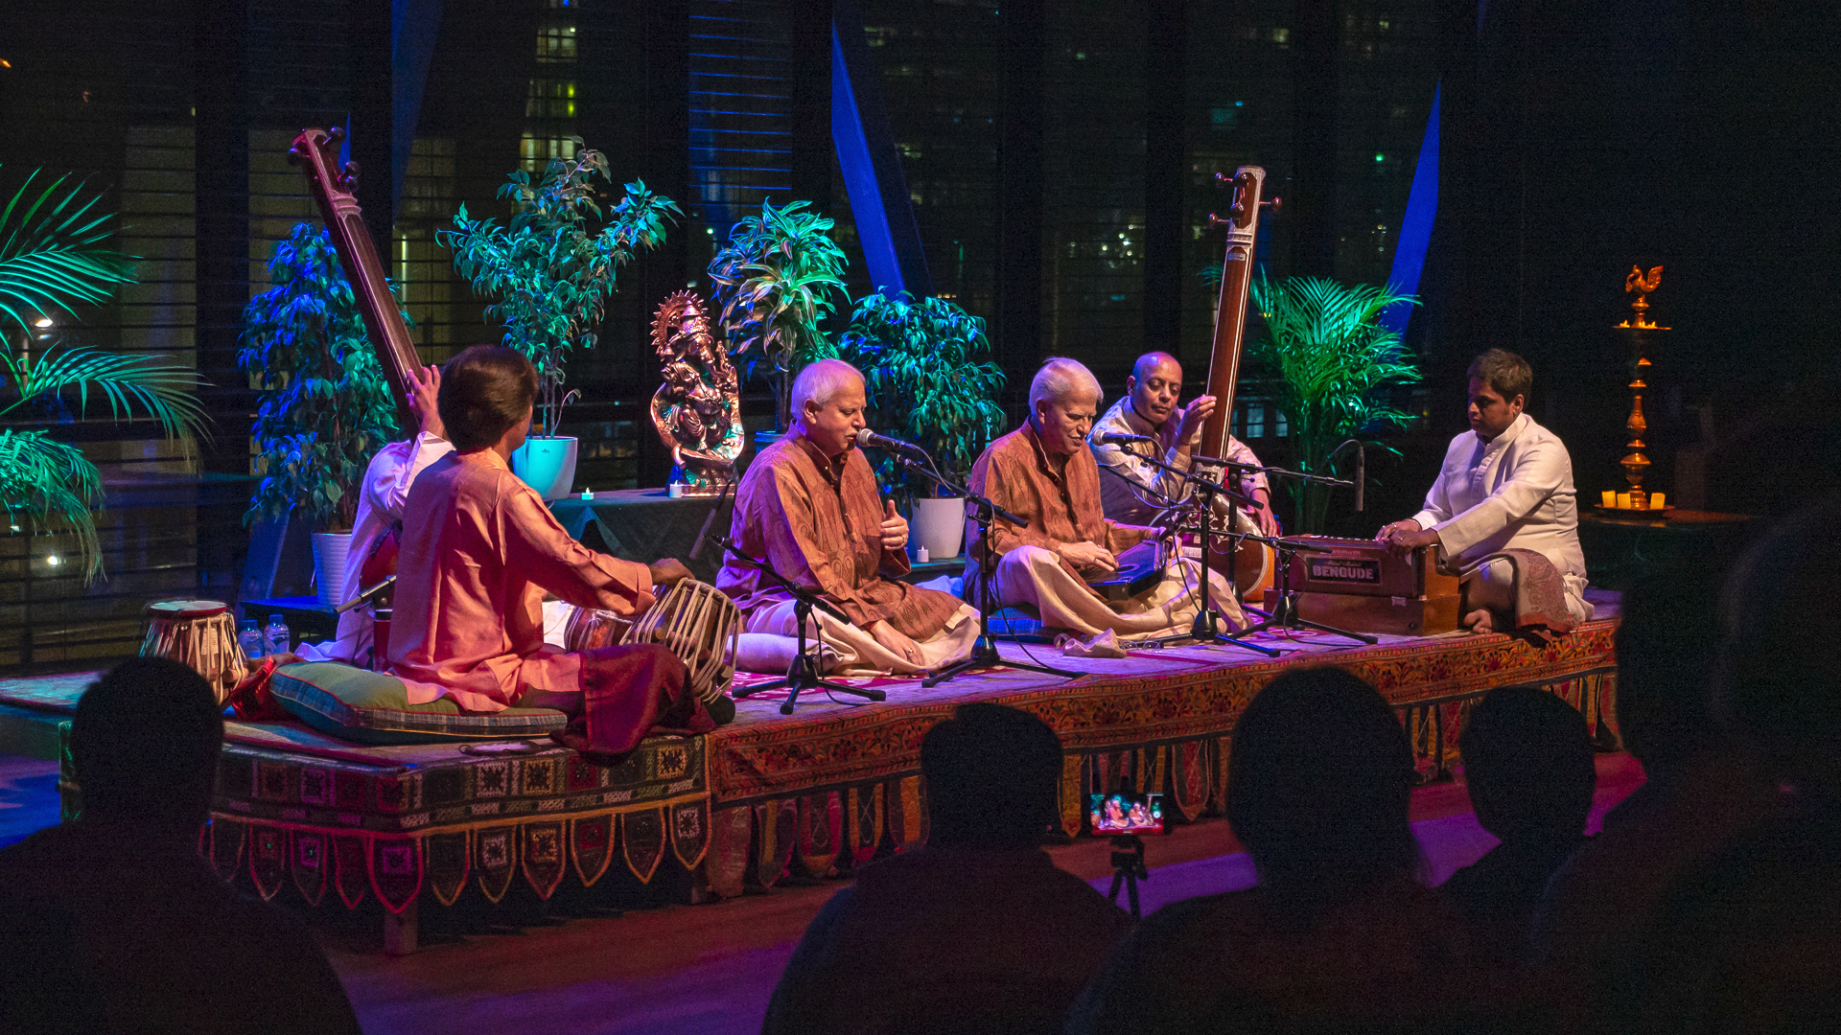
Hindustani classical music rituals
This is a picture from a Hindustani classical music concert. You can see that the musicians are on a stage with the audience sitting down in silence and in the dark – just like in classical music concerts in the UK.
Why do you think the audience is sitting like this?
Every type of music has rituals and customs associated with it – these aren’t always religious, but can be ways of being polite.

Slide 6
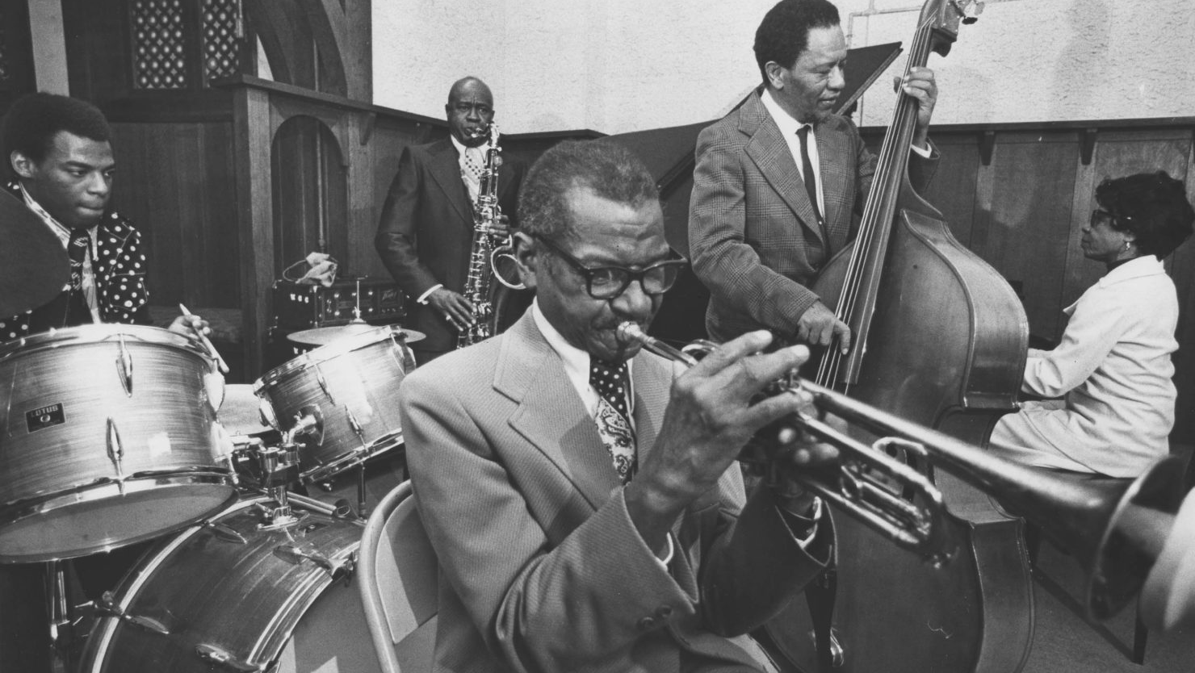
Changing rituals
What kind of music do people normally sing along to or dance to during a concert? Do these pictures give you a clue?
In other genres such as pop and jazz music, dancing is very common!

Slide 7
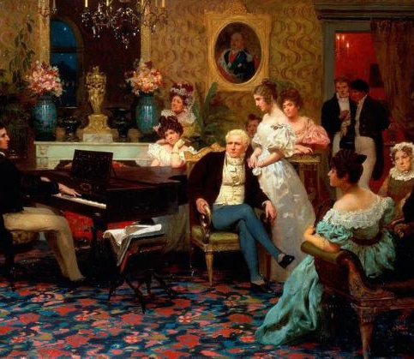
Changing rituals
When much classical music was written, codes of behaviour would have meant that dancing to this music was mostly frowned upon – the wealthy audiences would sit and listen, unless it was specifically dance music.
Wouldn’t it be nice to dance along to classical music too? Ask your parents to play some classical music at home and see if you can dance along – make your own ritual!

Slide 8
Activity 1
This is a piece by Georg Philipp Telemann, a composer who lived in Germany 300 years ago.
All hold hands and try to walk in a circle in time with the music – feel the ‘strong’ and ‘weak’ beats in your body.
In smaller groups, can you make up extra dance moves to the piece?

Slide 9
Musical rituals in everyday life
Where do you encounter music in your everyday life?
Do you listen to it while in the car?
What does the music of your favourite television shows sound like?
Do you play an instrument?

Slide 10
Traditional music in Scotland
Often, traditional music in Scotland was about everyday life, such as songs about household tasks and the landscapes people lived in.
Sometimes, bagpipers even played their instruments to tell people the time of day – there were no alarm clocks then! Would you like to be woken up to this sound?

Slide 11
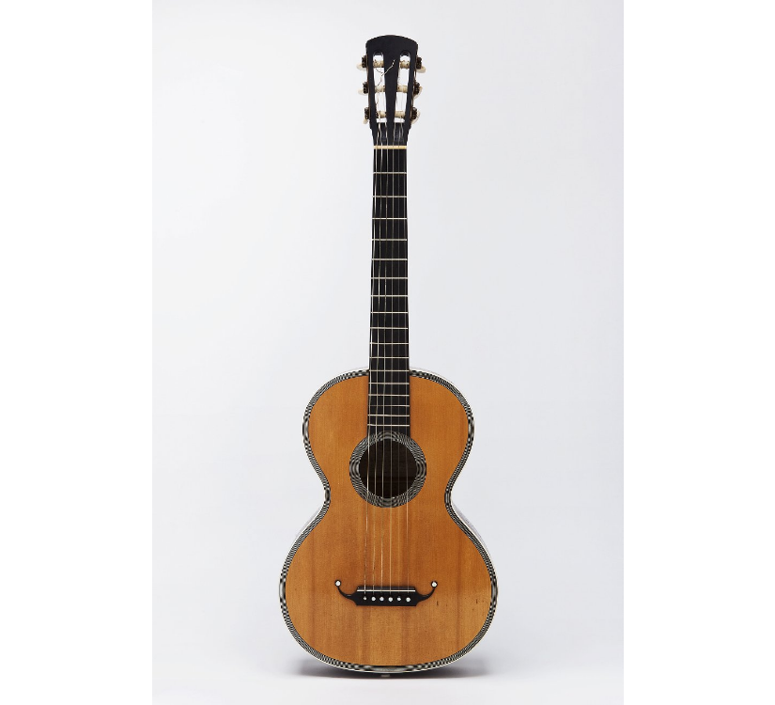
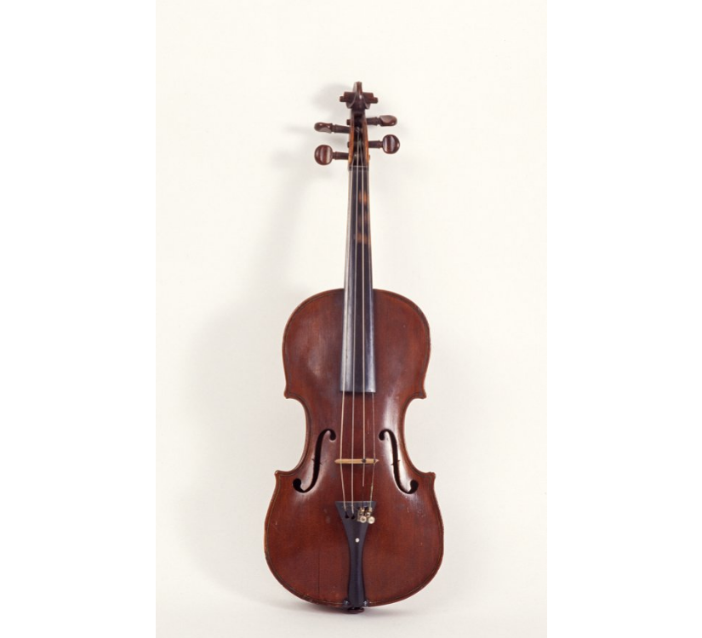
Traditional music in scotland
These are some other instruments used in Scottish traditional music – can you name them?
Tin Whistle
Guitar
Fiddle/Violin

Slide 12
Listen to this song called ‘Wild Mountain Thyme’ and follow the lyrics at the same time:
O the summer time has come And the trees are sweetly blooming The wild mountain thyme Grows around the blooming heather Will ye go, lassie, go?
And we'll all go together To pull wild mountain thyme All around the blooming heather Will ye go, lassie, go?
I will build my love a bower By yon cool crystal fountain And round it I will pile All the flowers of the mountain Will ye go, lassie, go?
Are there any words you don’t understand?
What are the themes in this song?

Slide 13
Activity 2: Making up a song about your life
If a song like ‘Wild Mountain Thyme’ were to be written now, what would the subject be? In groups or pairs, could you use a piece of music or a tune you know to make up your own song describing your life?
Think about these prompts:
what does your morning routine look like? - what is your favourite food and why? - where is your favourite place to be and why?
Then, each perform your song to the rest of the class!

Slide 14
Try incorporating music into an activity you do every day, like listening to music when you brush your teeth or singing when you get home from school.
Music is great for special occasions and formal rituals, but it can also be a fun everyday ritual!

